Slide 1
Module 8: Spark SQL
By Prof. Dr. Shanmugam Nandagopalan Ph. D
shanmugamnandagopalan@mfu.ac.th

Slide 2
Agenda
Introduction
Performance & Applications
Data Virtualization
Spark Libraries
Distributed JDBC/ODBC SQL Query Engine
ETL & Data Warehousing
Spark SQL Code Examples

Slide 3
Introduction
Spark SQL is a Spark library that runs on top of Spark.
It provides a higher-level abstraction than the Spark core API for processing structured data.
Structured data - Relational database, NoSQL data store, Parquet, ORC, Avro, JSON, CSV.
Used as a library for developing data processing applications in Scala, Java, Python, or R.
It supports multiple query languages, including SQL, HiveQL, and language integrated queries.

Slide 4
Spark Libraries

Slide 5
Key Features
Easier to use than the Spark core.
Provides a higher-level API and abstraction
Functions for selecting columns, filtering rows, aggregating columns, joining datasets, and other common data processing and analytic tasks.
Improves productivity
Process structured data with less code
Supports a variety of data sources
Data processing interfaces: SQL, HiveQL and language integrated queries

Slide 6
Performance
Runs faster: reduced disk I/O, in-memory columnar caching, query optimization, and code generation.
Reduces disk I/O wherever possible.
Partitioning is a proven technique for improving read performance.
Horizontal(Row) and Vertical(Column) based Partitioning .
Allows reading of only the columns that are used in a query.
Cache data in an in-memory columnar format from any data source.
Query Optimization-analysis phase, logical optimization phase, physical planning phase, code generation phase.

Slide 7
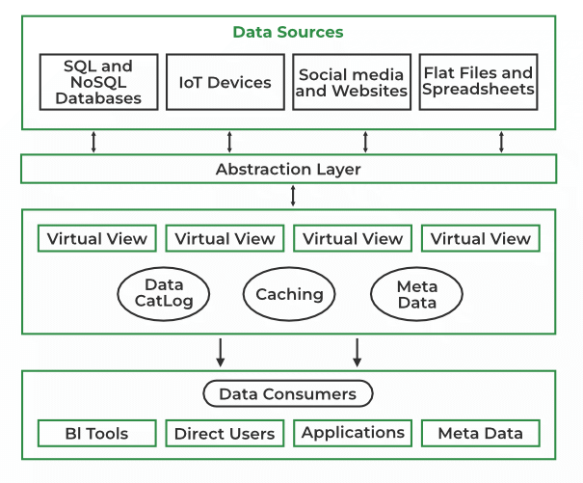
Data Virtualization
It can extract data from a wide range of sources.
Data from multiple sources can be integrated easily.
All the heterogeneous data sources is seen as one logical database.
E.g. E-Commerce: merge sales, inventory, and customer, supplier data.

Slide 8
Distributed JDBC/ODBC SQL Query Engine
JDBC – Java Database Connectivity
ODBC – Open Database Connectivity
Spark SQL can be used in two ways:
as a library and distributed SQL query engine.
Multiple users can share a single Spark cluster.
Spark SQL JDBC/ODBC server looks like a database

Slide 9
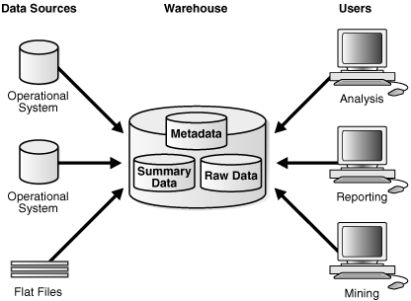
ETL & Data Warehouse
DWH is a database that is used to store and analyze large amounts of multidimensional data.

Slide 10
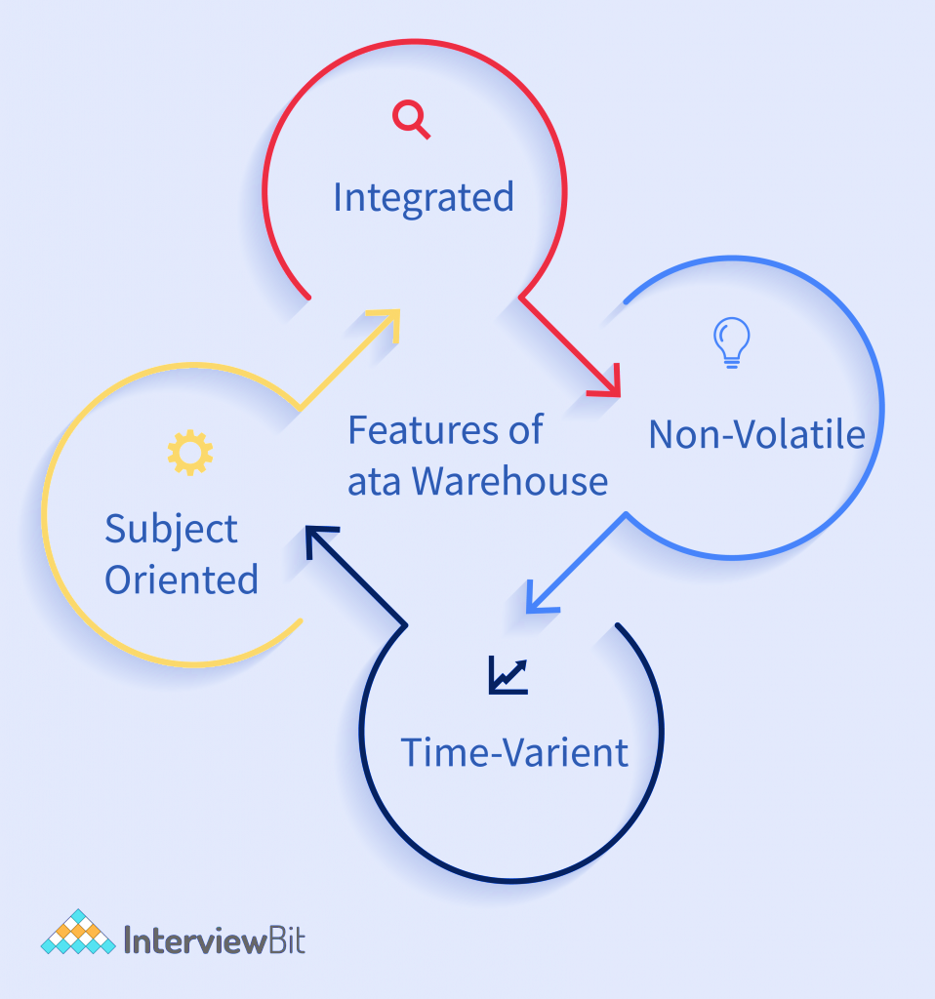
Features of Data Warehouse
A data warehouse does not require transaction processing, recovery, and concurrency controls, because it is physically stored and separate from the operational database.

Slide 11
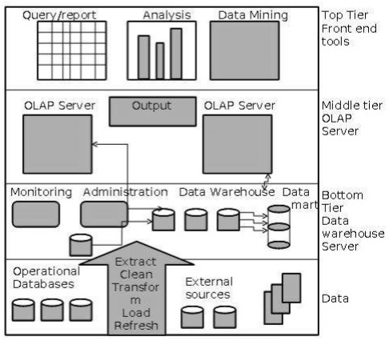
Components of Data Warehouse

Slide 12
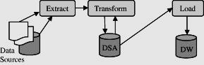
ETL OVERVIEW
It encompass the areas of data acquisition and data storage.
These are back-end processes that cover the extraction of data from the source systems.
What is the scope and extent of the data you will extract from the source systems?
Avoid creating a data junkhouse by dumping all the available data from the source systems
All three functions of ETL must be carried out for successful transforming of data into information.

Slide 13
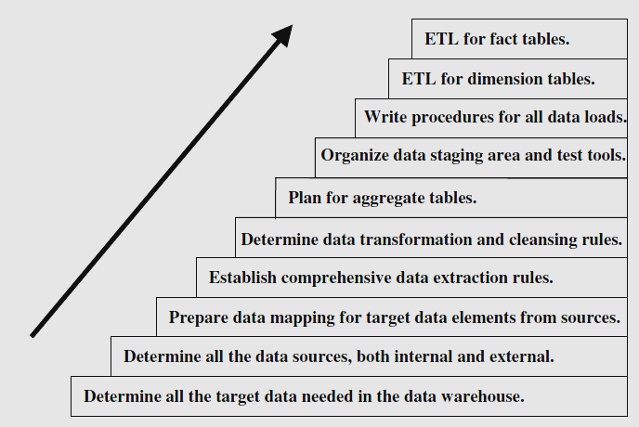
ETL – Major Steps

Slide 14
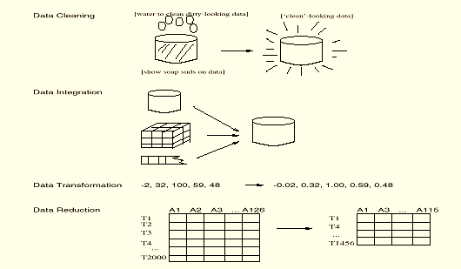
Data Preprocessing

Slide 15
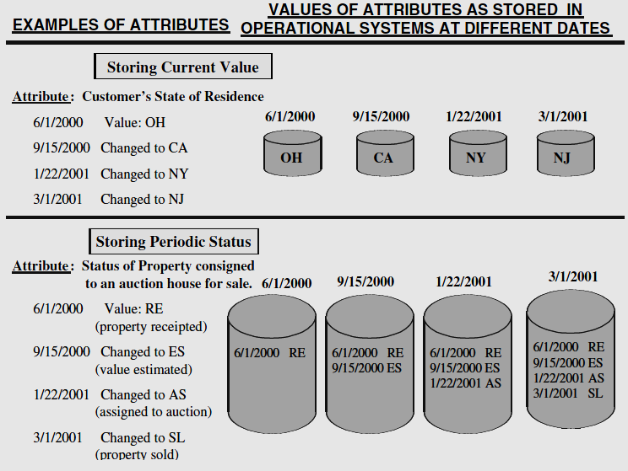
Data Extraction

Slide 16
Data Transformation
Smoothing: remove noise from data
Aggregation: summarization, data cube construction (e.g. Daily sales into monthly sales)
Generalization: low level data is replaced by high level concepts
Normalization: scaled to fall within a small, specified range
min-max normalization
z-score normalization
normalization by decimal scaling
Attribute/feature construction
New attributes constructed from the given ones

Slide 17
Data Transformation: Normalization
Min-max normalization: to [new_min_{A}, new_max_{A}]
Ex. Let income range $12,000 to $98,000 normalized to [0.0, 1.0]. Then $73,000 is mapped to
Z-score normalization (μ: mean, σ: standard deviation):
Ex. Let μ = 54,000, σ = 16,000. Then
Normalization by decimal scaling
Where j is the smallest integer such that Max(|ν’|) < 1

Slide 18
Data Loading
The whole process of moving data into the data warehouse repository.
Initial Load—populating all the data warehouse tables for the very first time
Incremental Load—applying ongoing changes as necessary in a periodic manner
Full Refresh—completely erasing the contents of one or more tables and reloading with fresh data.
During the loads, the data warehouse has to be offline.
Issues: In the fact table row, the concatenated key may be wrong and not correspond to the dimension tables
Straightforward method for applying data - writing special load programs

Slide 19
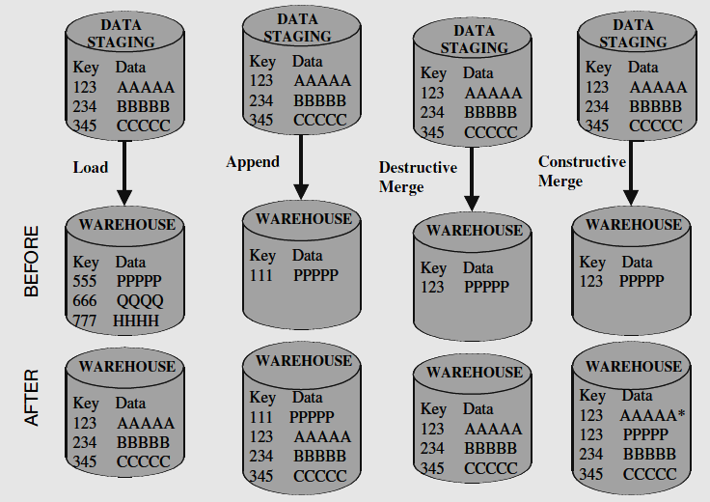
Modes of Applying Data

Slide 20
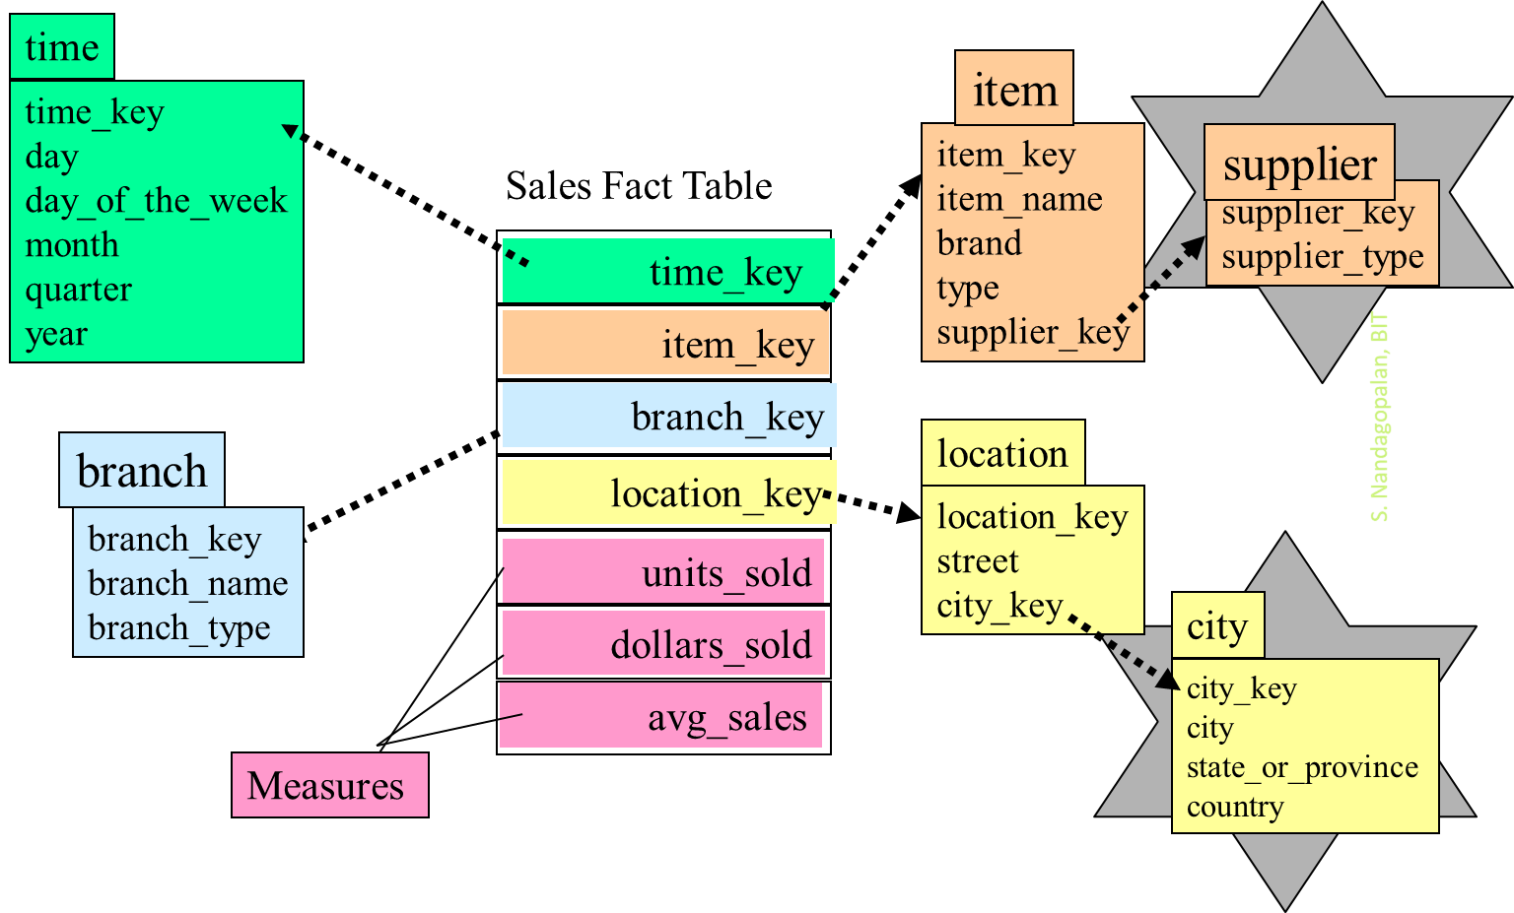
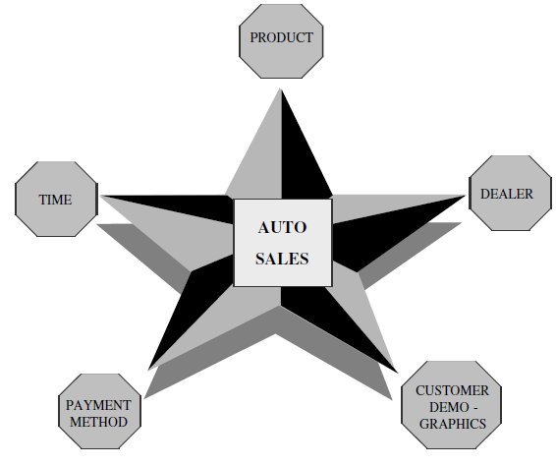
Dimensional Modelling
Star Schema: data is organized into facts and dimensions.

Slide 21
Example
The user wants to compare and analyze sales by store, by product, and by month
The sale figures are available in the several sales applications in your company.
You have a product master file.
Each sales transaction refers to a specific store.
The sales units and dollars in a fact table.
The products in a product dimension table.
The stores in a store dimension table, and months in a time dimension table. How do you do this?
Extract the data from each of the operational systems, reconcile the variations in data representations among the source systems, and transform all the sales of all the products. Then load the sales into the fact and dimension tables.

Slide 22
Multidimensional Data & Cube
Date
1Qtr
2Qtr
3Qtr
4Qtr
sum
Product
TV
PC
U.S.A
VCR
sum
Canada
Country
Mexico
sum
All, All, All

Slide 23
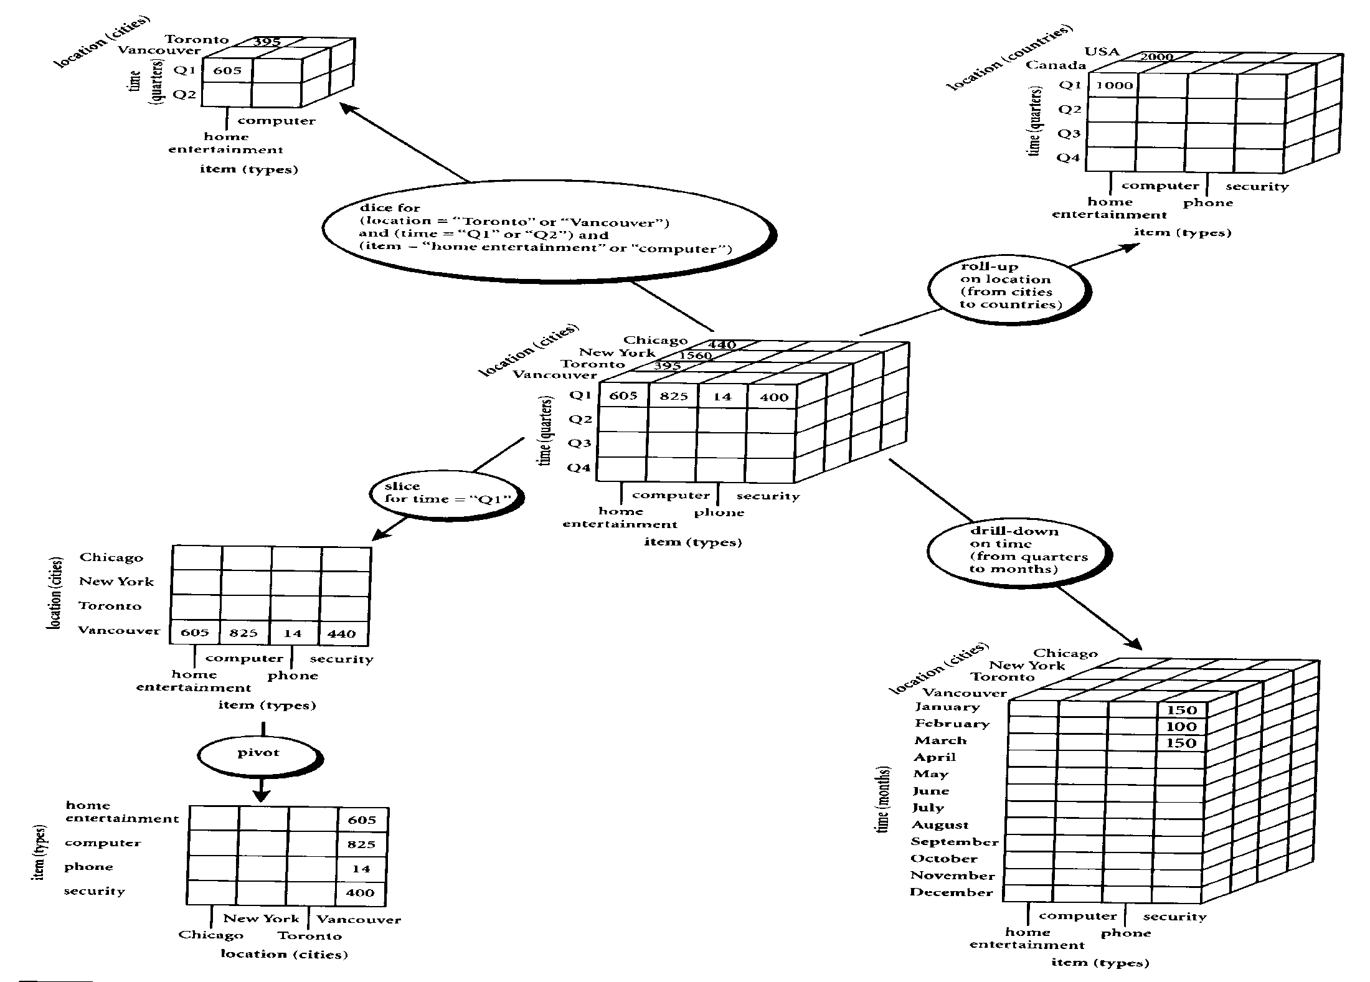
OLAP Manipulations

Slide 24
Application Programming Interface (API)
Spark SQL library - supports Scala, Java, Python and R.
Allows you to embed SQL/HiveQL within your application.
Three key abstractions: SQLContext, HiveContext and DataFrame.
A Spark SQL application processes data using these abstractions.
SQLContext:
SQLContext is the main entry point into the Spark SQL library.
SQLContext is required to create instances of the other classes provided by the Spark SQL library.
It is also required to execute SQL queries.

Slide 25


Spark-SQL Code Examples
Spark-SQL using PySpark & Jupyter
Spark-Scala, SQL, IntelliJ IDE
Spark-Scala, MySQL, IntelliJ IDE

Slide 26
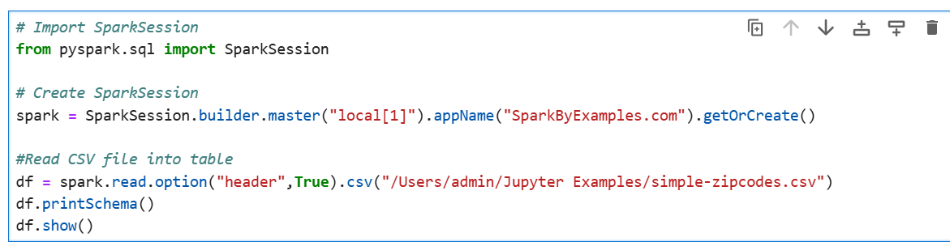
Spark-SQL using PySpark & Jupyter
# Create temporary table
spark.read.option("header",True)
.csv("/Users/admin/Jupyter Examples/simple-zipcodes.csv")
.createOrReplaceTempView("Zipcodes")

Slide 27
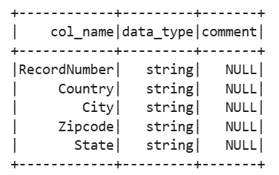
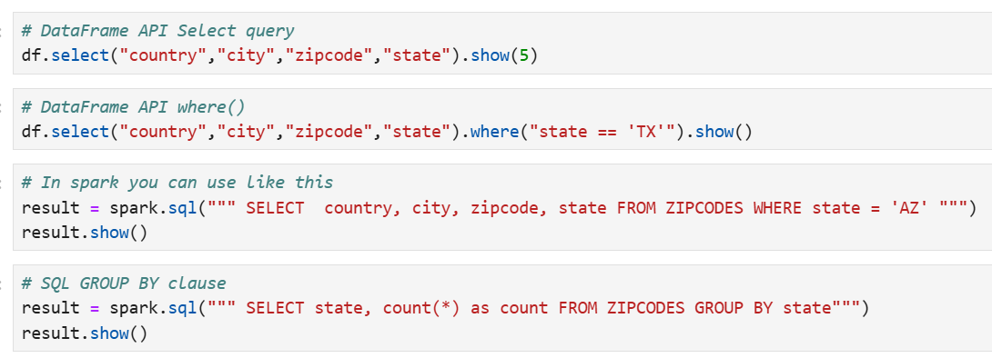
Contd…

Slide 28
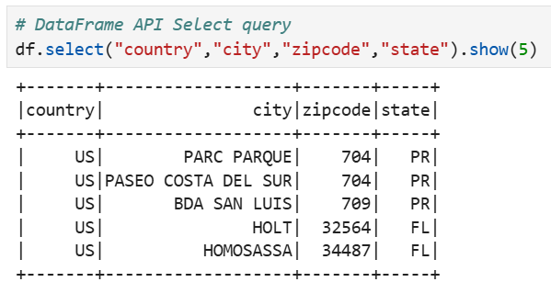
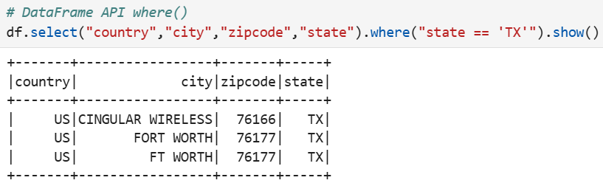
Output

Slide 29
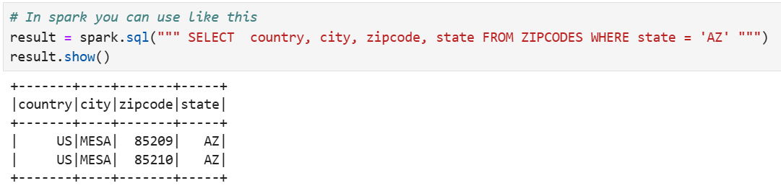
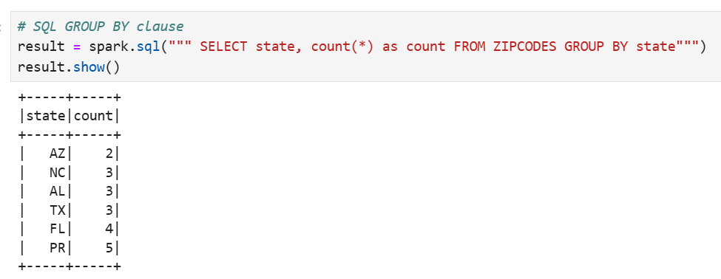
Contd…

Slide 30
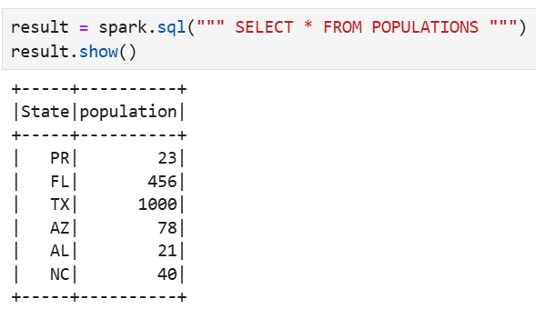
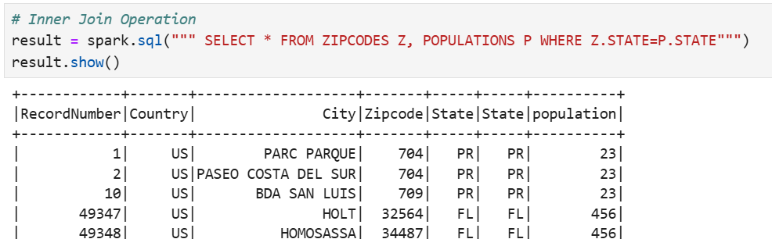

Slide 31
Spark-Scala, SQL, IntelliJ IDE
Step 1: Make sure that you have installed Java 11 or 8
Step 2: Download Spark 3.5.3 and install
Step 3: Download IntelliJ IDE and install
To install Spark and IntelliJ (Community Edition), follow the below YouTube video:
https://www.youtube.com/watch?v=ipw-Sv_jkeY
In case if you get any errors, go through the following video:
https://www.youtube.com/watch?v=UGwgsbY0JA4

Slide 32
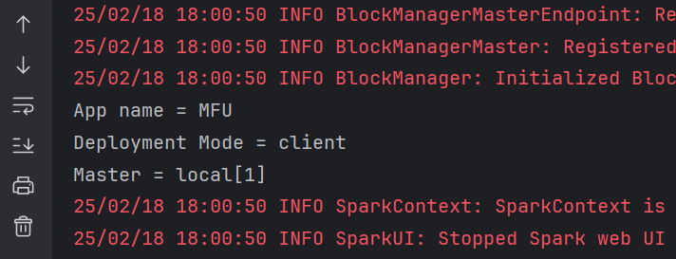
Sample Scala Code
Note that we are using Maven project for this exercise. Maven is an open-source tool that helps manage and build projects.
Make sure that the project folder structure is as mentioned in the above screenshot.
Your scala program should be in this folder:
C:\Users\Admin\IdeaProjects\BDAPrj\src\BDAPrj\HelloWorld.scala
Step 4: To test the Spark-Scala, type the below code in IntelliJ IDE:
// Basic Spark Scala Program
package BDAPrj
import org.apache.spark.sql.SparkSession
object HelloWorld{
def main (args:Array[String]):Unit={
val spark = SparkSession.builder()
.master(master = "local[1]")
.appName(name = "MFU")
.getOrCreate()
println("App name = " + spark.sparkContext.appName)
println("Deployment Mode = " + spark.sparkContext.deployMode)
println("Master = " + spark.sparkContext.master)
spark.stop()
}
}

Slide 33
Spark-Scala, SQL, IntelliJ IDE
Working with SQL (without MySQL Database)
// Demo Scala program to show the working of SQL
package BDAPrj
import org.apache.spark.sql.SparkSession
object ScalaDemo {
def main(args: Array[String]): Unit = {
val spark = SparkSession.builder()
.master(master = "local[1]")
.appName(name = "ScalaDemo")
.getOrCreate()
println("App name = " + spark.sparkContext.appName)
println("Deployment Mode = " + spark.sparkContext.deployMode)
println("Master = " + spark.sparkContext.master)
// Necessary for dataframe creation
import spark.implicits._
// create spark dataframe
val spark_df = Seq(
(1, "Patrick", 10),
(2, "Lisbon", 10),
(3, "Cho", 20),
(4, "Rigsby", 20),
(5, "Scott", 10)).toDF("sno", "name", "deptid")
// create temp view
spark_df.createOrReplaceTempView("My_Spark_Table")
// select from the temp view using spark sql
spark.sql("Select * from My_Spark_Table").show()
// Get count of employees in each department using spark sql
spark.sql("Select deptid, count(*) from My_Spark_Table group by deptid").show()
spark.stop()
}
}

Slide 34
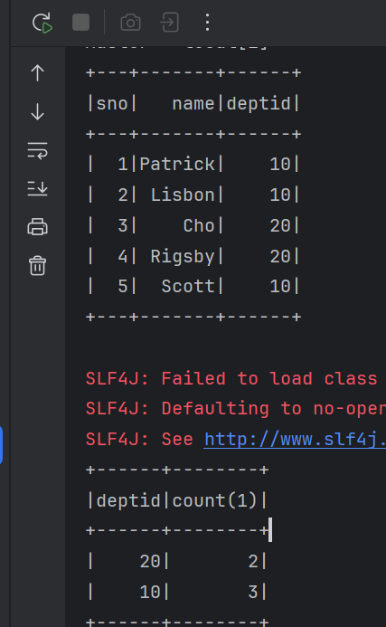
Output

Slide 35
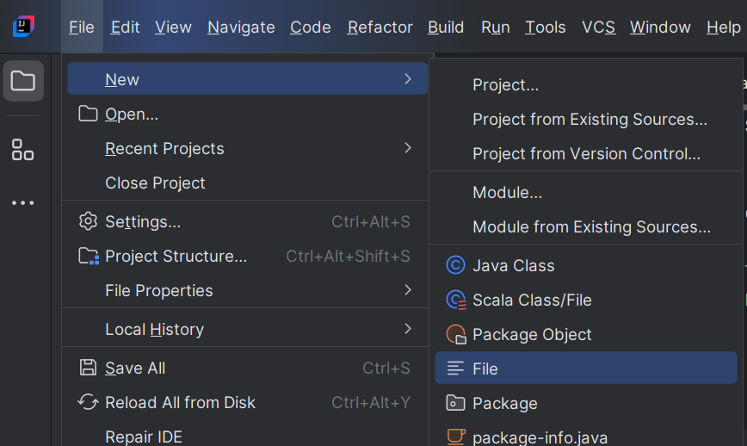
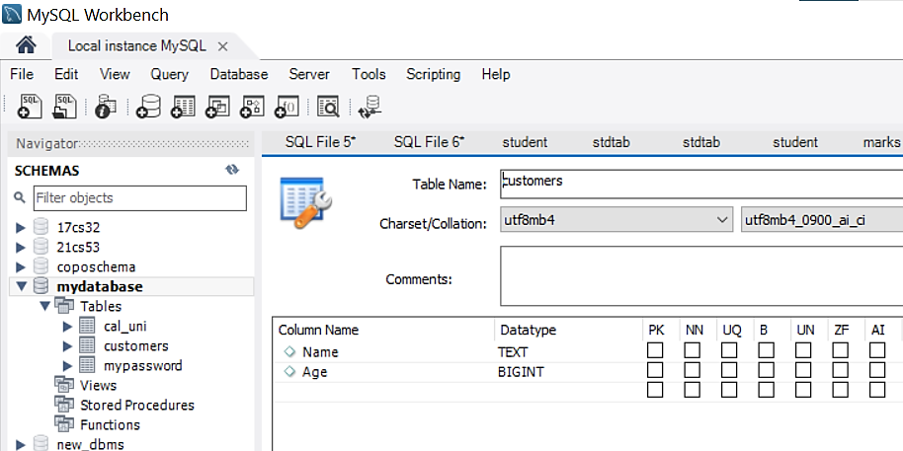
Working with JDBC-MySQL
Step 1: Create a new File: File→New→File.
Name it as JDBCDemo.scala
Step 2: Make sure that you have the database and Table created in MySQL Workbench.
Database name : mydatabase
Table Name : Customers
User name : root
Password : admin

Slide 36
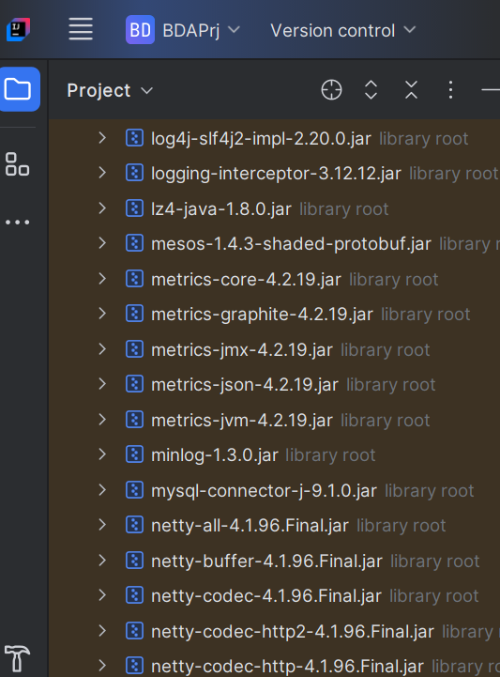
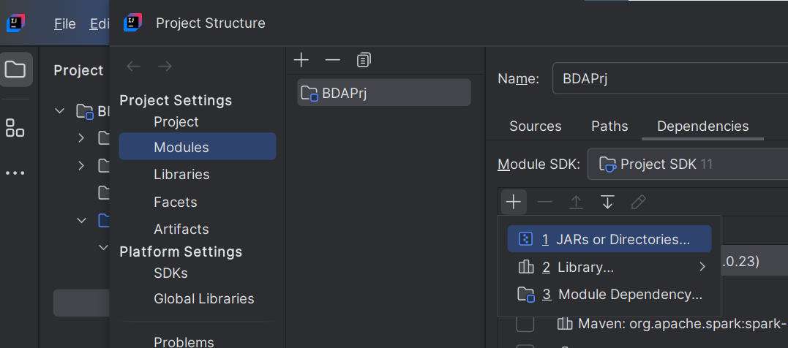
Contd…
Step 3: Add the JDBC Connector jar files to the external Library
To add the JDBC driver folder, click
File→Project Structure→Modules→Dependencies→+
Download the connector:
https://dev.mysql.com/downloads/connector/j/?os=26

Slide 37
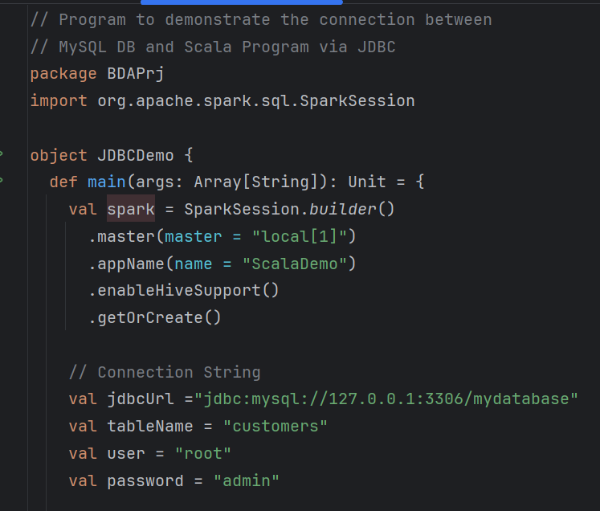
Contd…
Step 4: Type the below scala program in the file JDBCDemo.scala:

Slide 38
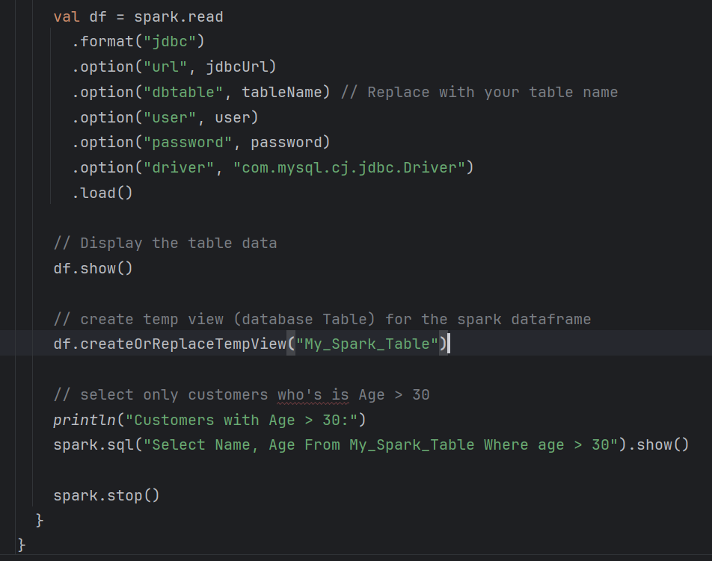
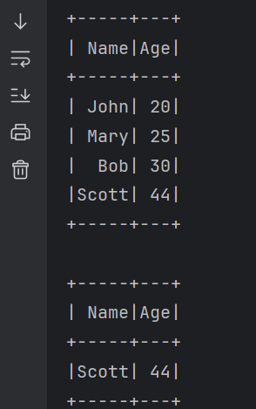
Contd…

Slide 39
MS SQL-Server, SSMS, & OLAP
How to set up a Multidimensional Database?
How to work on Slicing, Dicing, Drilldown, Rollup, etc.?

Slide 40
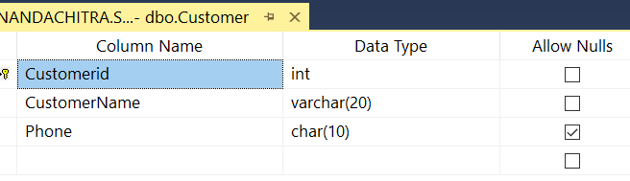
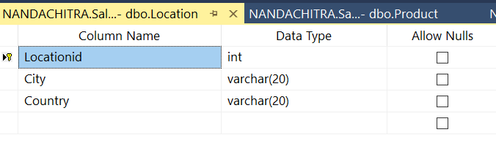
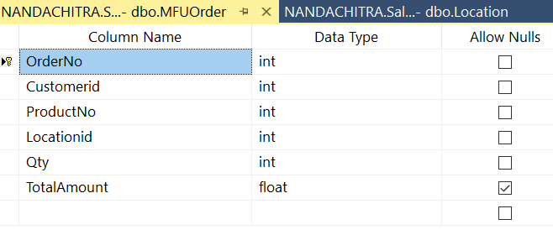
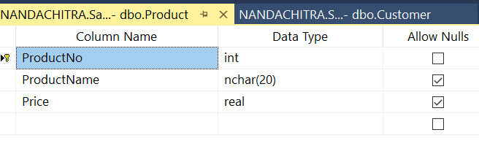
Building a Multidimensional Database "Sales"
Problem 1: Create a Multidimensional Database called "Sales" with Dimensional Tables: Customer, Product, and Location. Also create a Fact table called "MFUOrder".

Slide 41
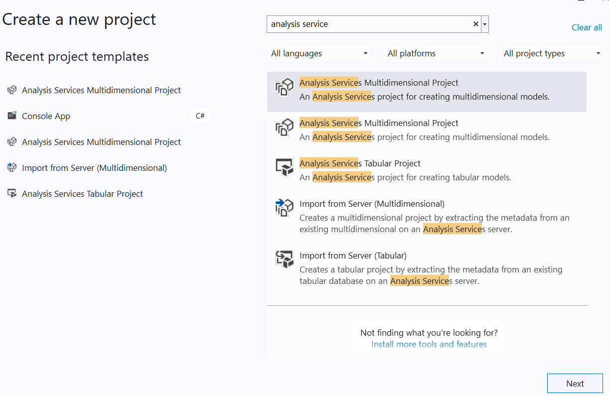
Building a Cube in VS Studio 2022

Slide 42
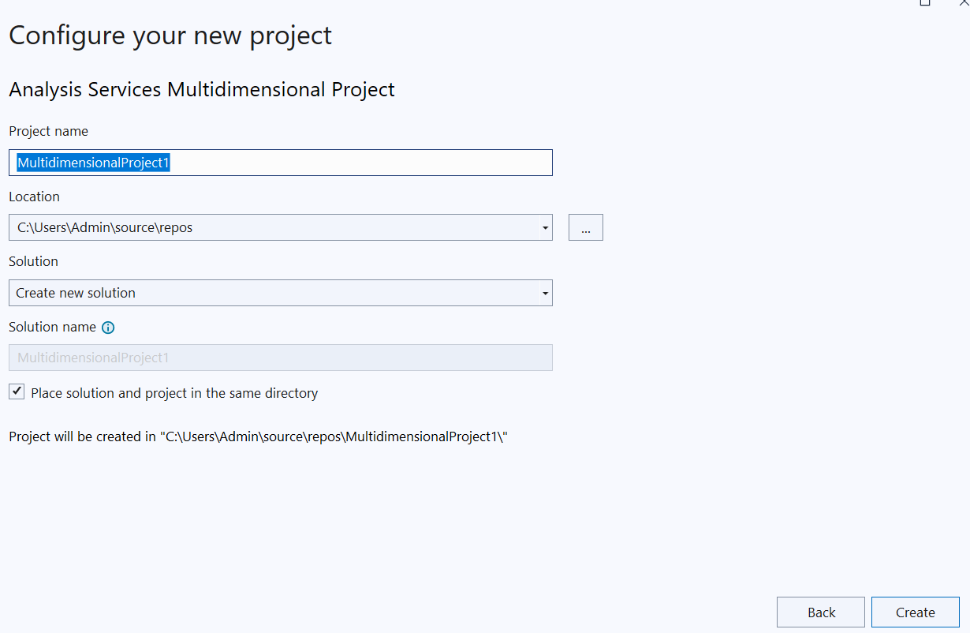
Contd…

Slide 43
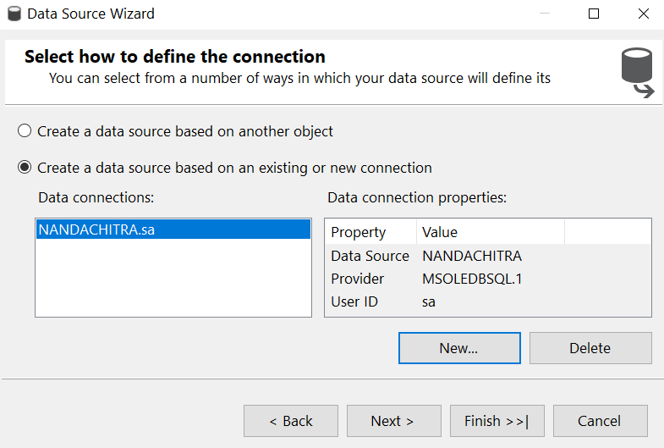
Contd…

Slide 44
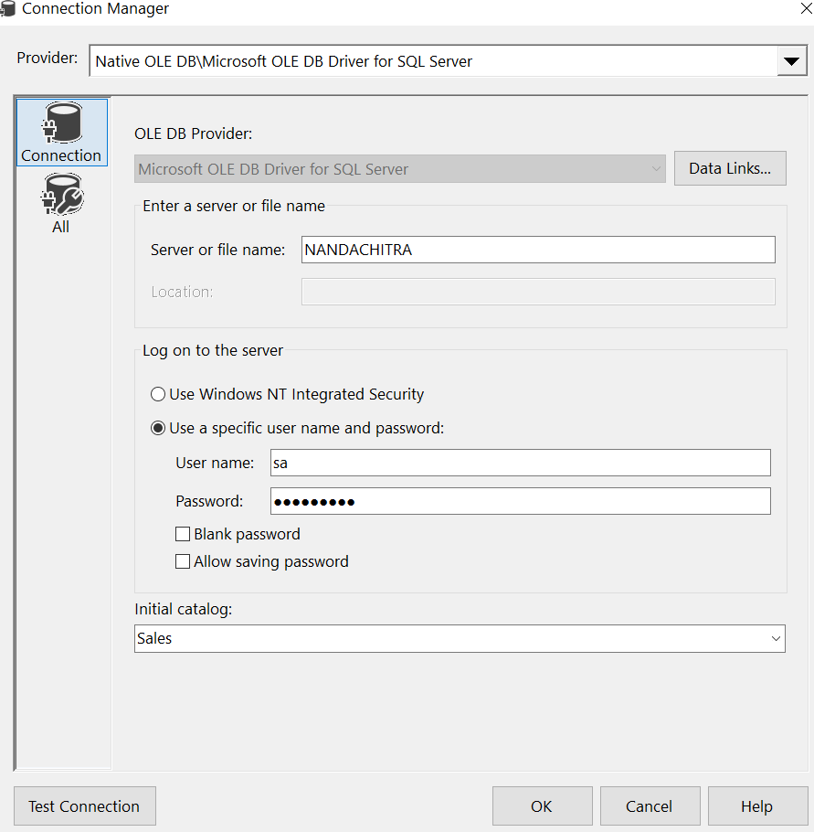
Contd…

Slide 45
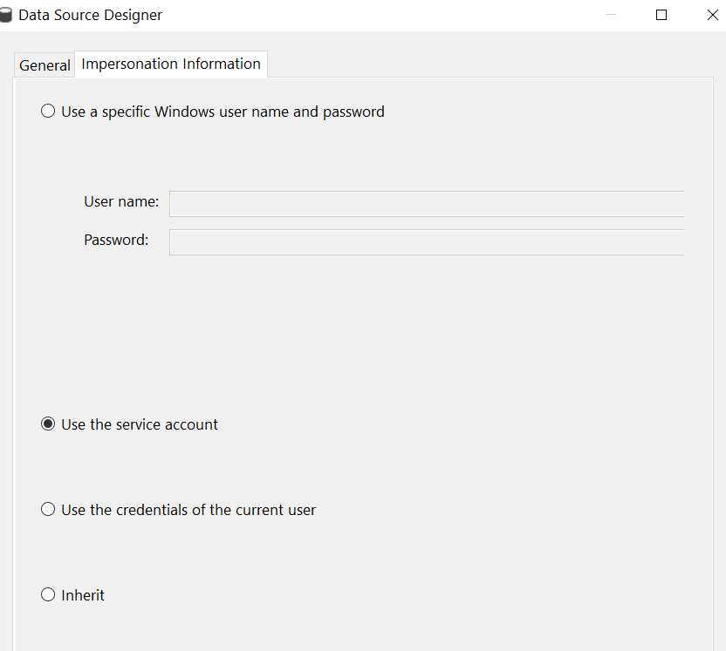
Contd…

Slide 46
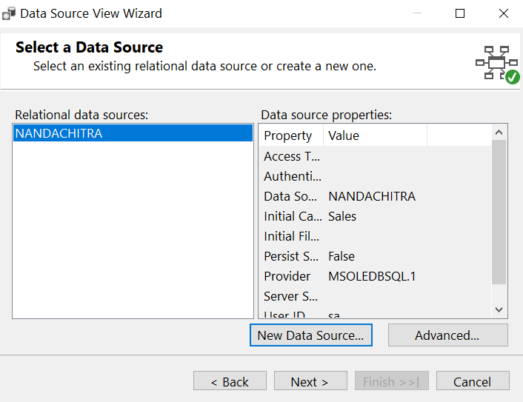
Contd…

Slide 47
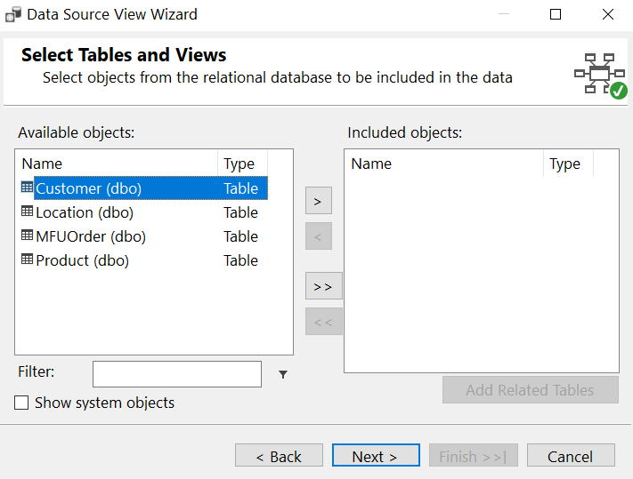
Contd…

Slide 48
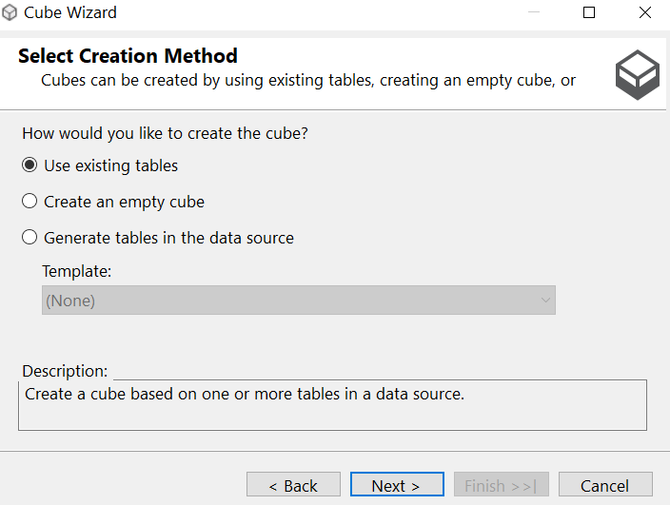
Contd…

Slide 49
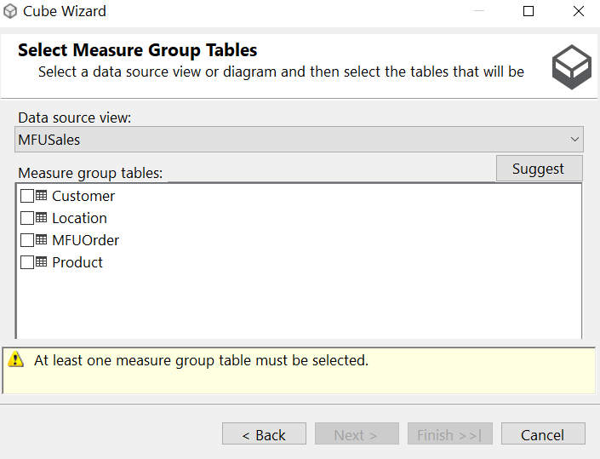
Contd…

Slide 50
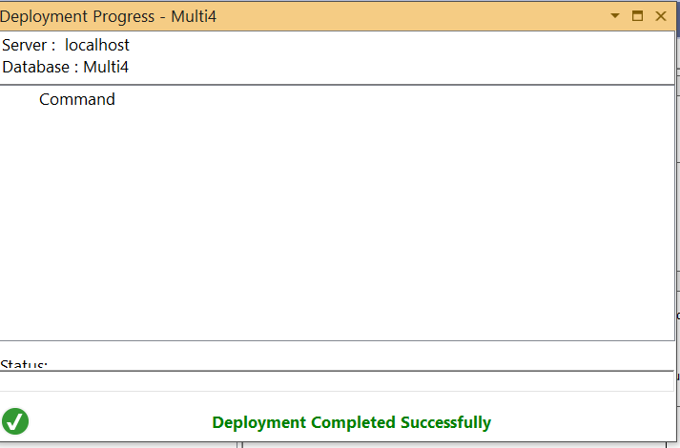
Contd…

Slide 51
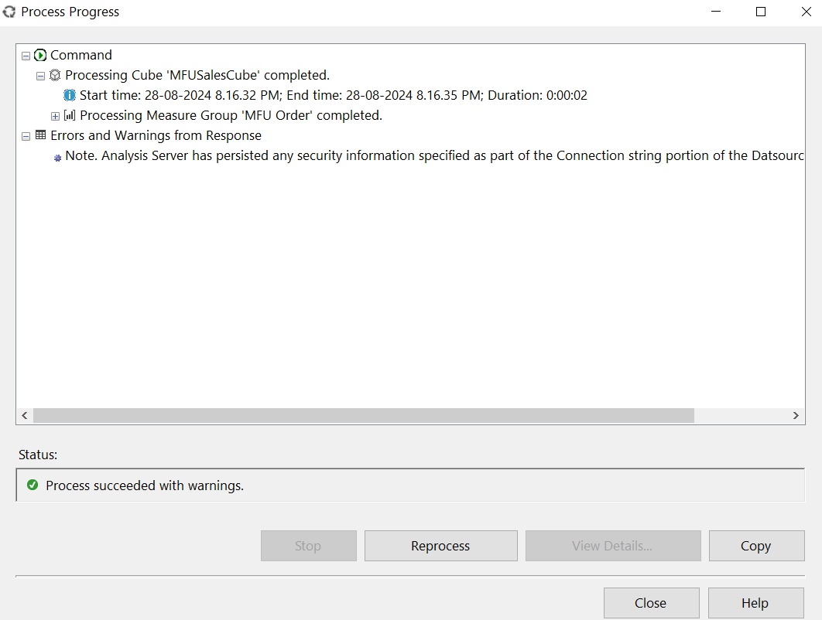
Contd…

Slide 52
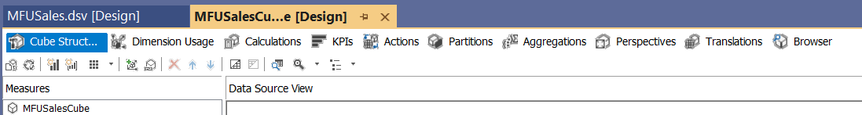
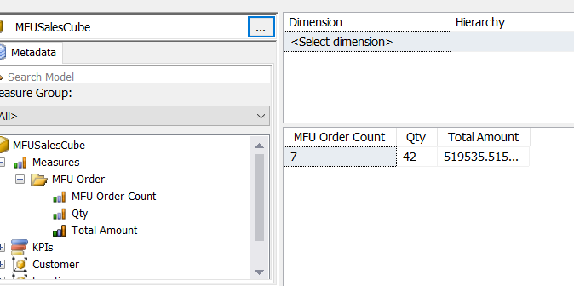
Contd…

Slide 53
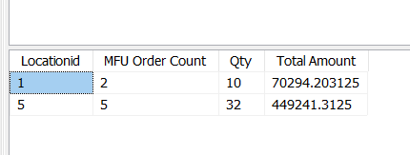
Contd…

Slide 54
Demo….

Slide 55
Thank You

